Slide 1
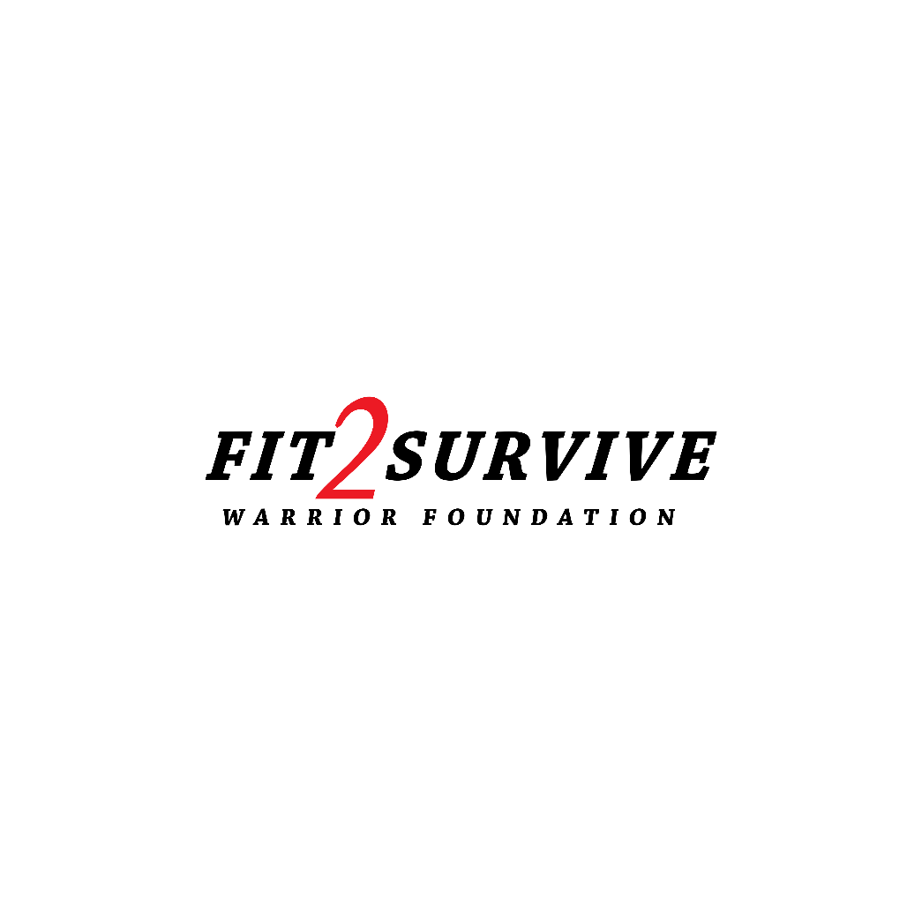

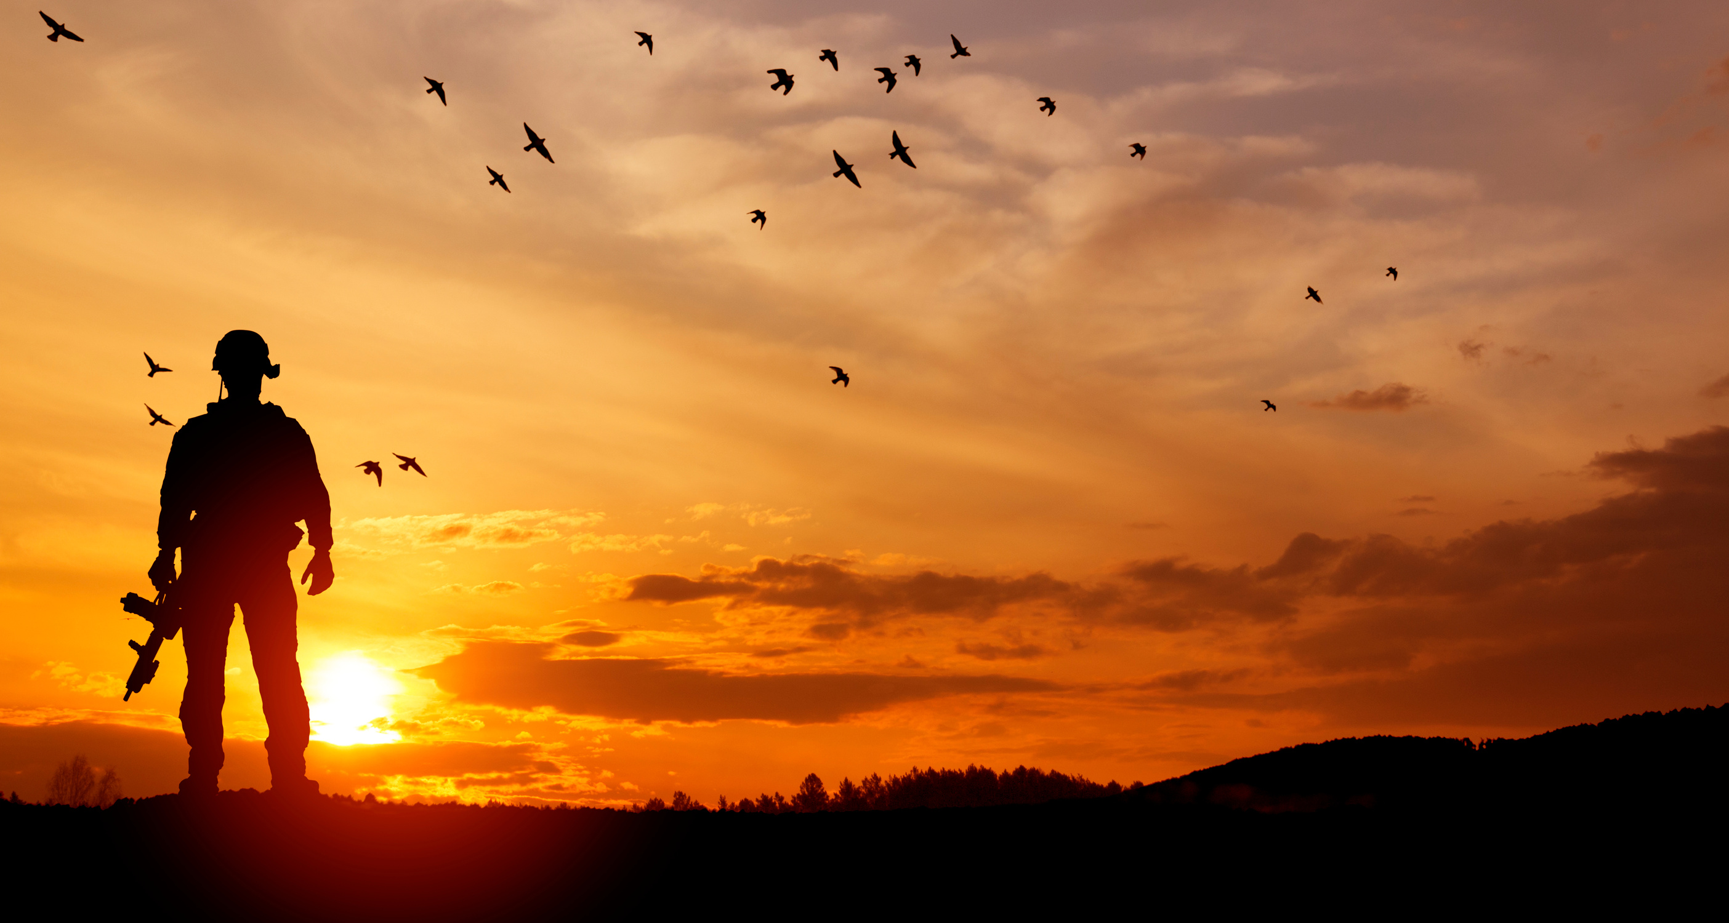
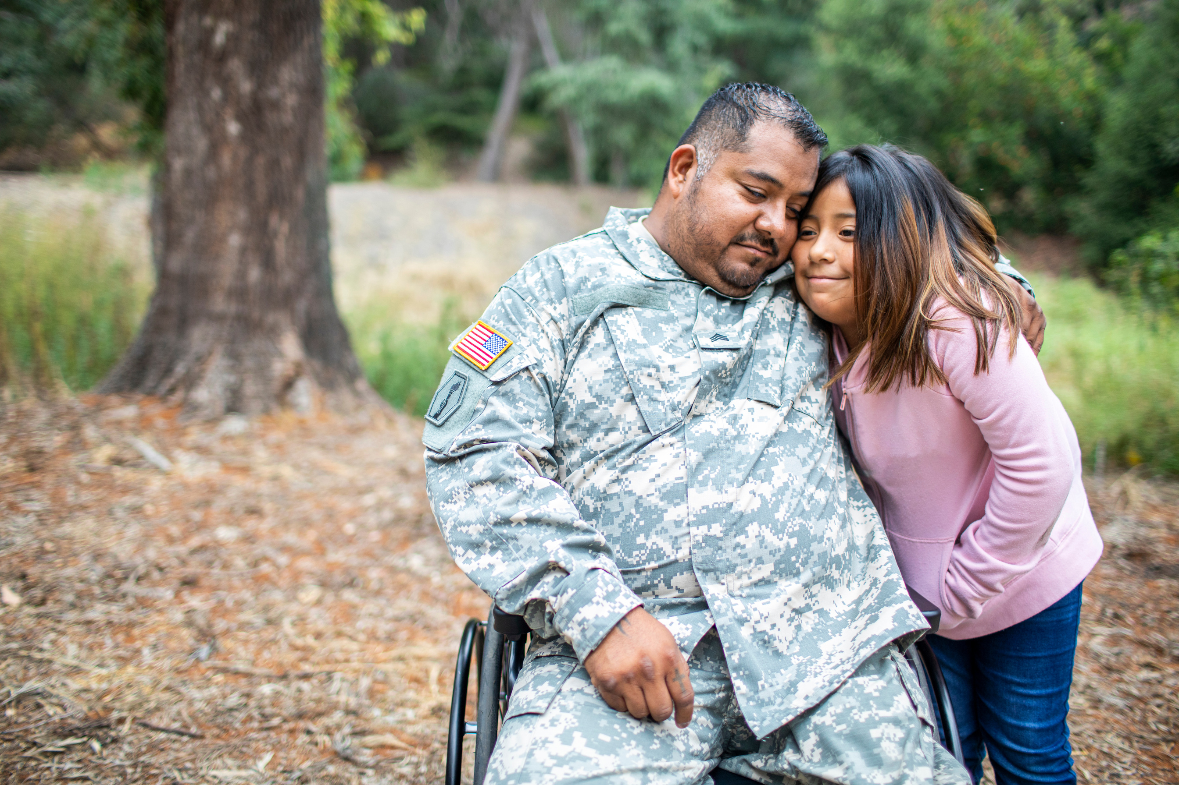
FIT2SURVIVE WARRIOR FOUNDATION INC
Transforming Lives Through Active Resilience

Slide 2


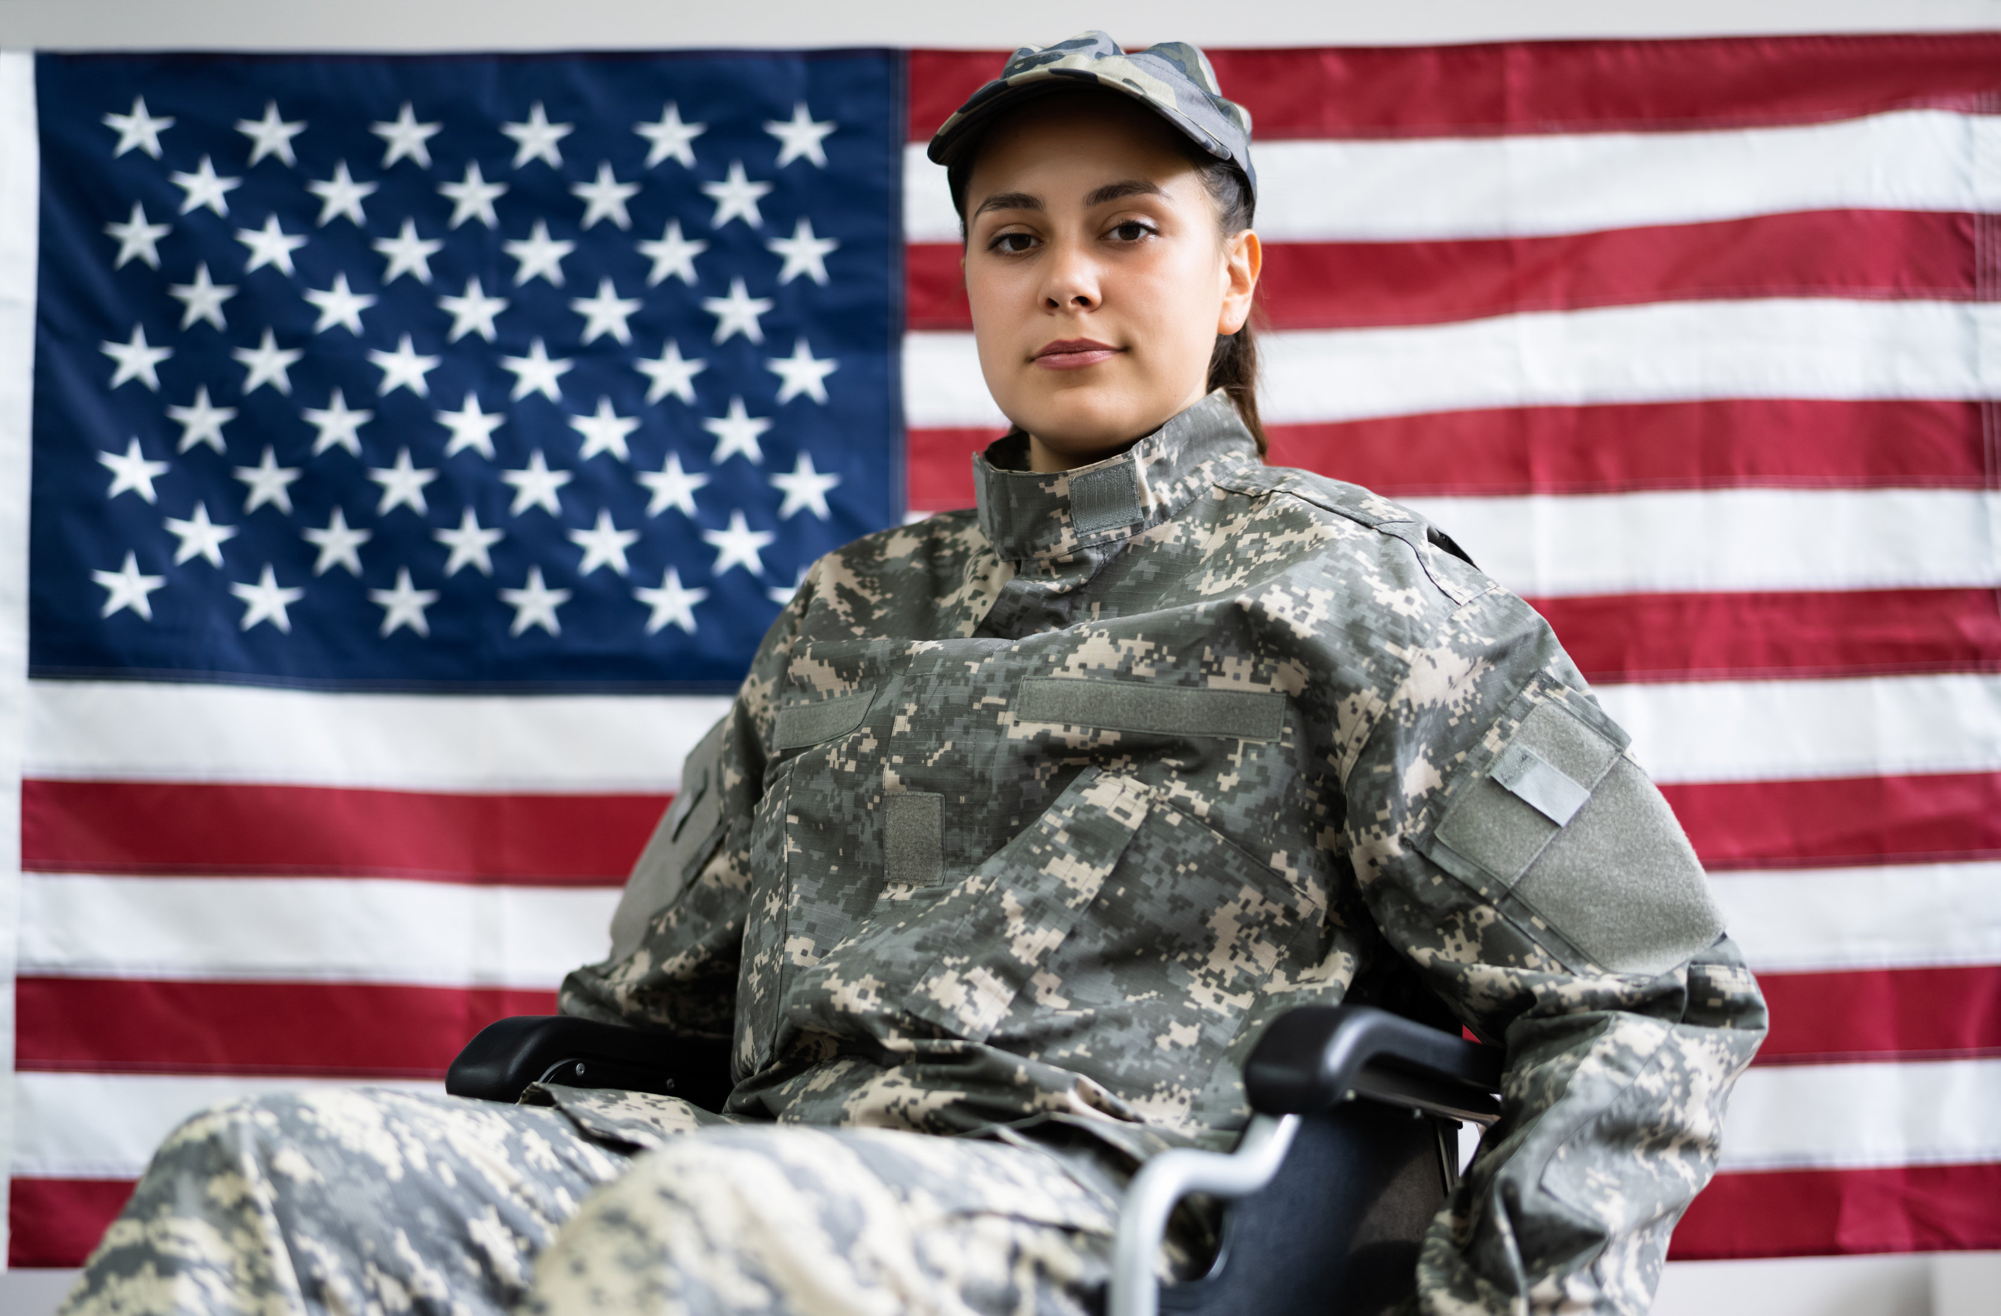
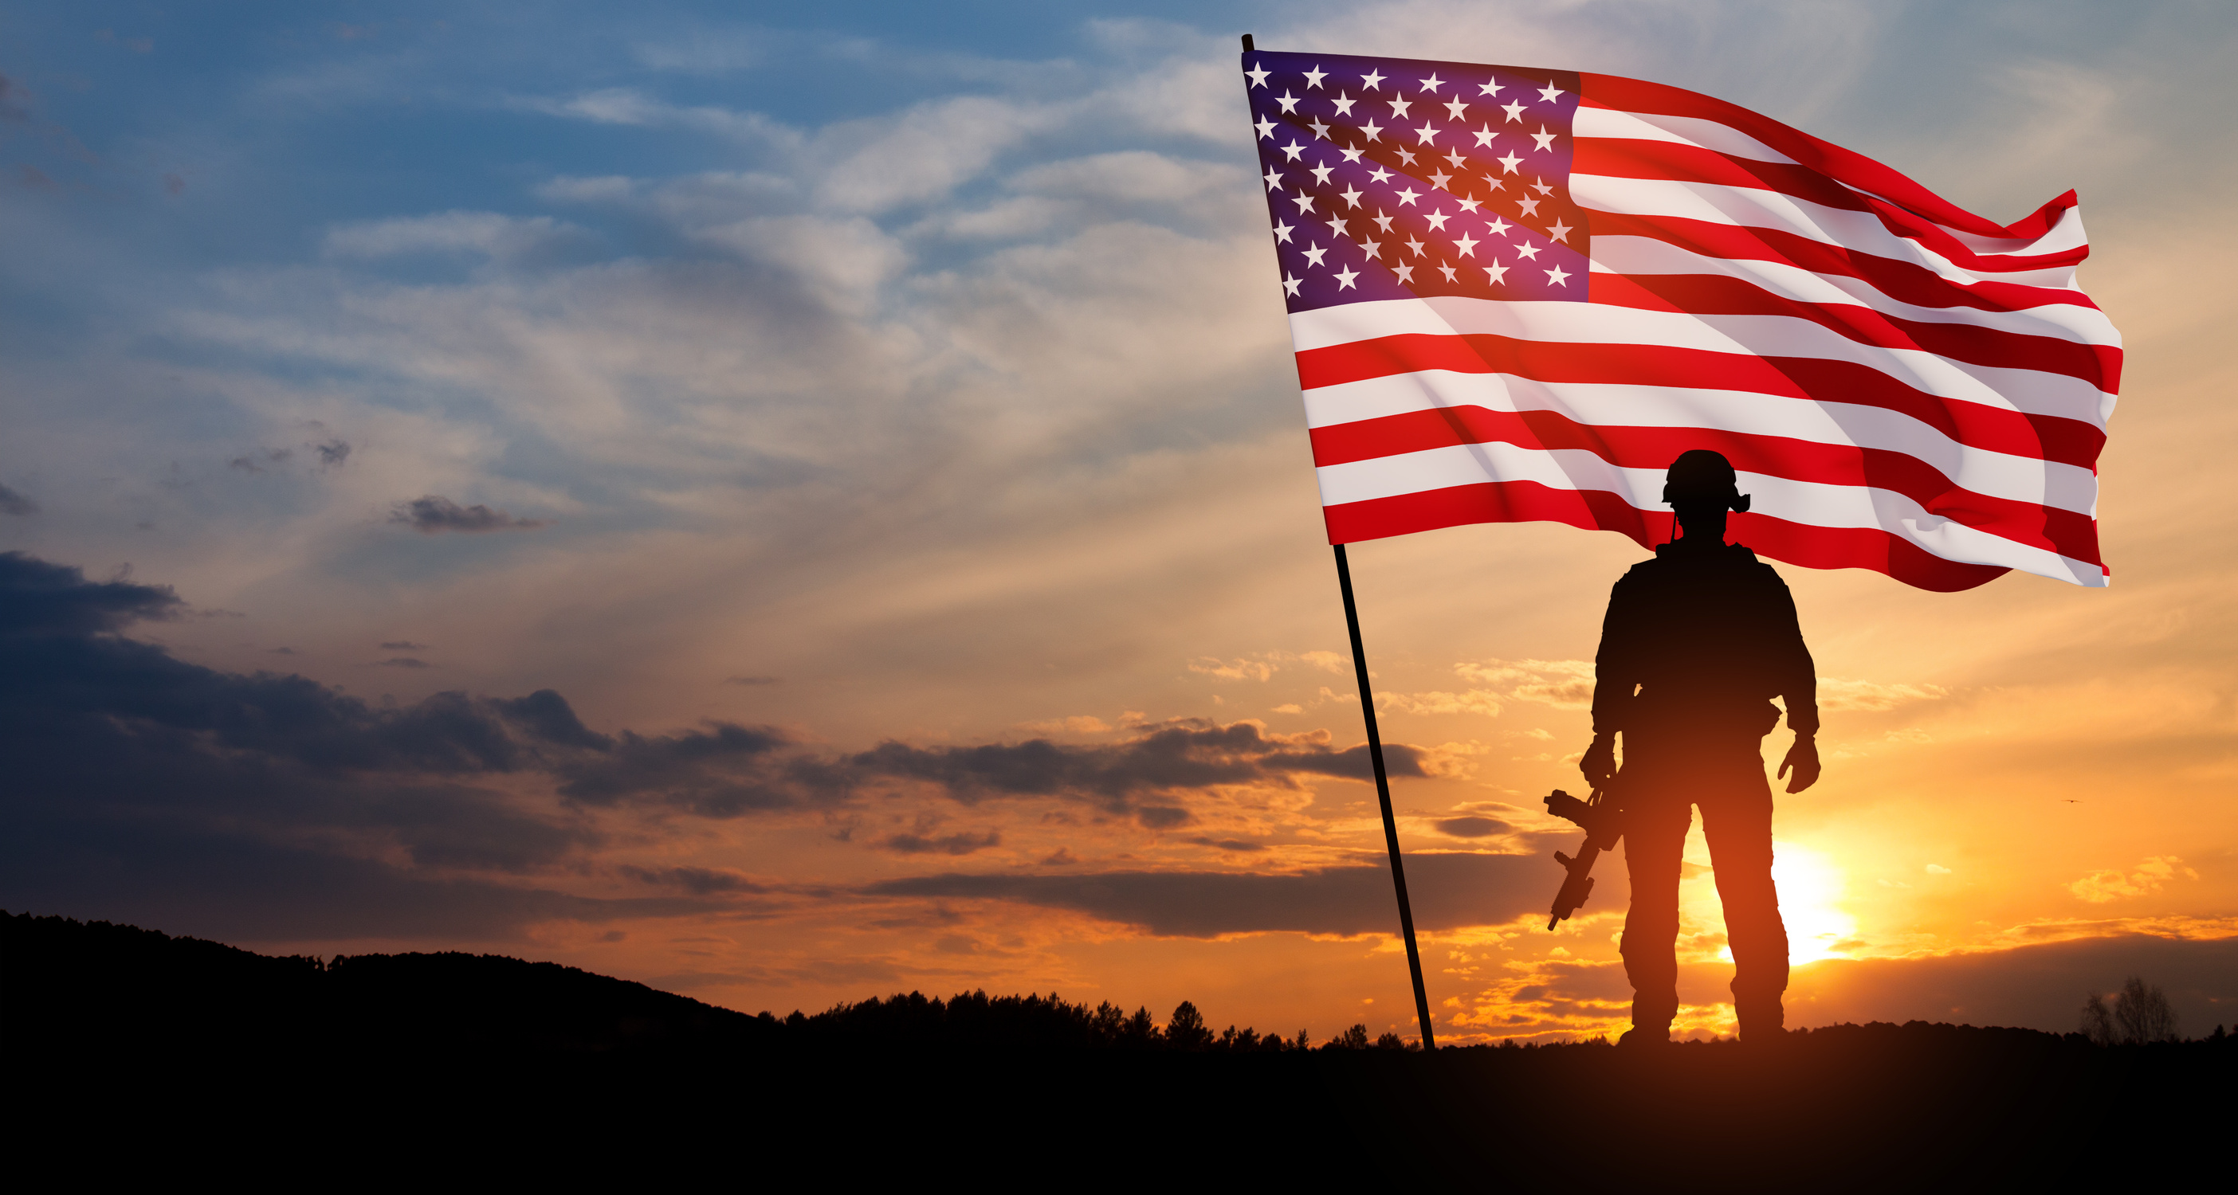
PROBLEMS STATEMENT
Problem: Limited Support for Post-Rehabilitation mental and physical health issues.
Statistics:
  Active Duty: Approximately 13 - 15% of active-duty service members experience symptoms of depression, according to recent data from the Department of Defense.
  Veterans: 20 - 25% of veterans face depression and related mental health issues, highlighting a significant ongoing challenge even after leaving active duty.
  Regular physical activity has been shown to reduce symptoms of depression by up to 30%, as supported by multiple studies, including those published in the Journal of Clinical Psychiatry.
  60-70% of individuals with depression experienced a reduction in symptoms through consistent physical activity.
  Research indicates physical activity can lower the risk of suicide by 25 -35% among those with depression. The U.S. Department of Veterans Affairs reports that service members who engage in regular exercise have significantly lower suicide rates compared to those who are inactive.
Addressing this gap is crucial for enhancing the well-being of our heroes.
Studies demonstrate that service members who participate in structured physical rehab programs have up to 50% higher rate of recovery from severe injuries compared to those who do not engage in these activities. Regular exercise can improve overall mobility and reduce long-term disability.
These statistics underscore the critical role health and fitness plays in addressing both mental health challenges and physical injuries, reinforcing the importance of incorporating physical activity into recovery and rehabilitation programs for military personnel.

Slide 3

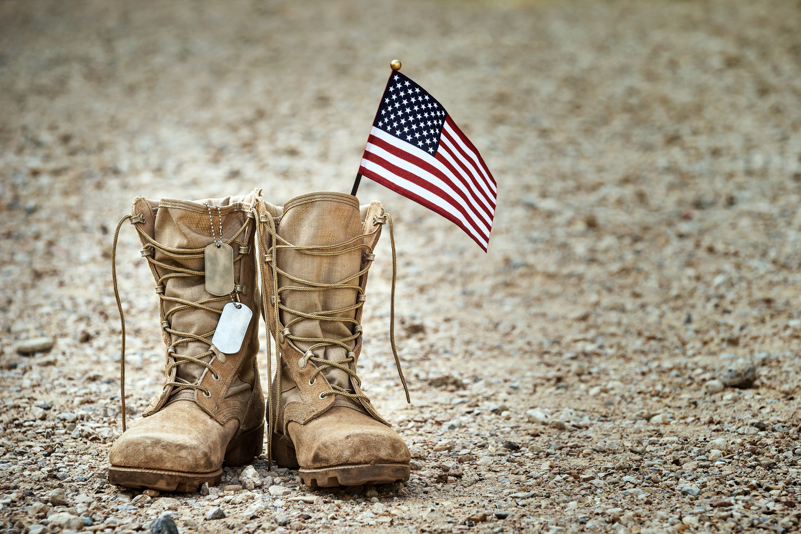


OUR SOLUTION: EMPOWERMENT
At FIT2SURVIVE WARRIOR FOUNDATION INC. we offer a holistic approach to supporting military men and women. Our comprehensive solution includes:
  Specialized Equipment: Tailored to individual needs for enhanced mobility.
  Fitness Programs: Enabling physical and mental well-being for active lifestyles.
  Event Participation: Sponsorships and support for veterans and active duty military in competitive and recreational events.
  Comprehensive support: Extending aid to hospitals, doctors and individuals ensuring care and counseling for PTSD, depression and other mental health related injuries.
  Together, these elements form a powerful support system, empowering our heroes through fitness to overcome challenges and thrive in their pursuit of a active fulfilling life.

Slide 4


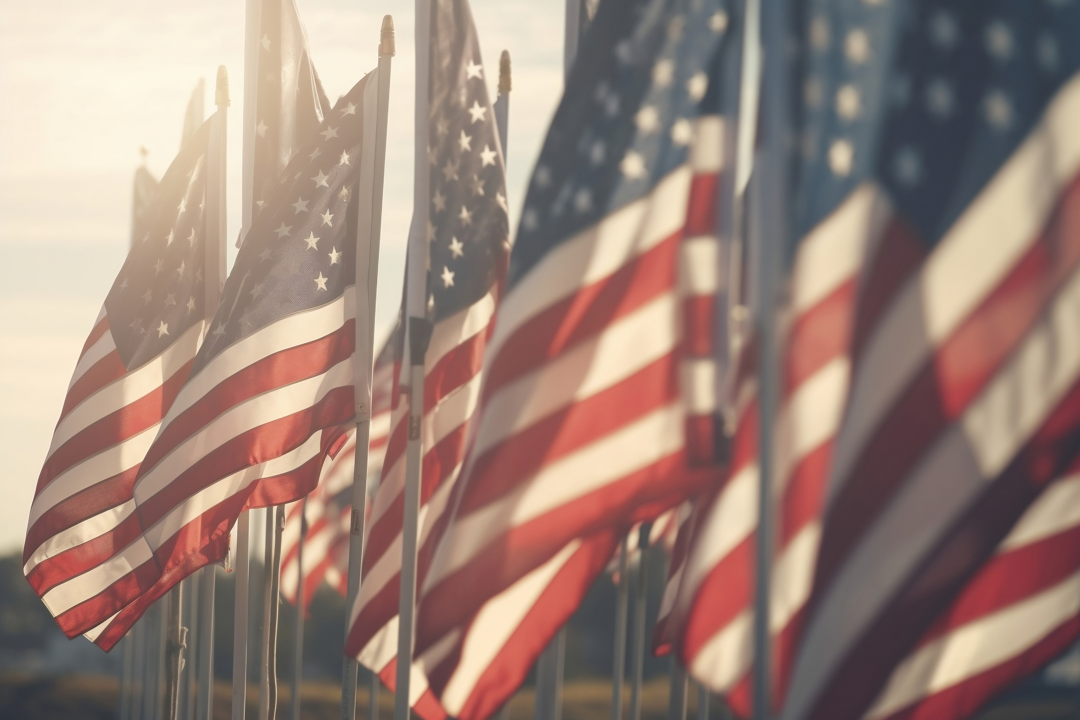

MISSION
VISION
To ensure all wounded and limb deficient military personnel have the best opportunity to live more active fulfilling lives.
To honor and inspire wounded and amputee military personnel through health and fitness.

Slide 5
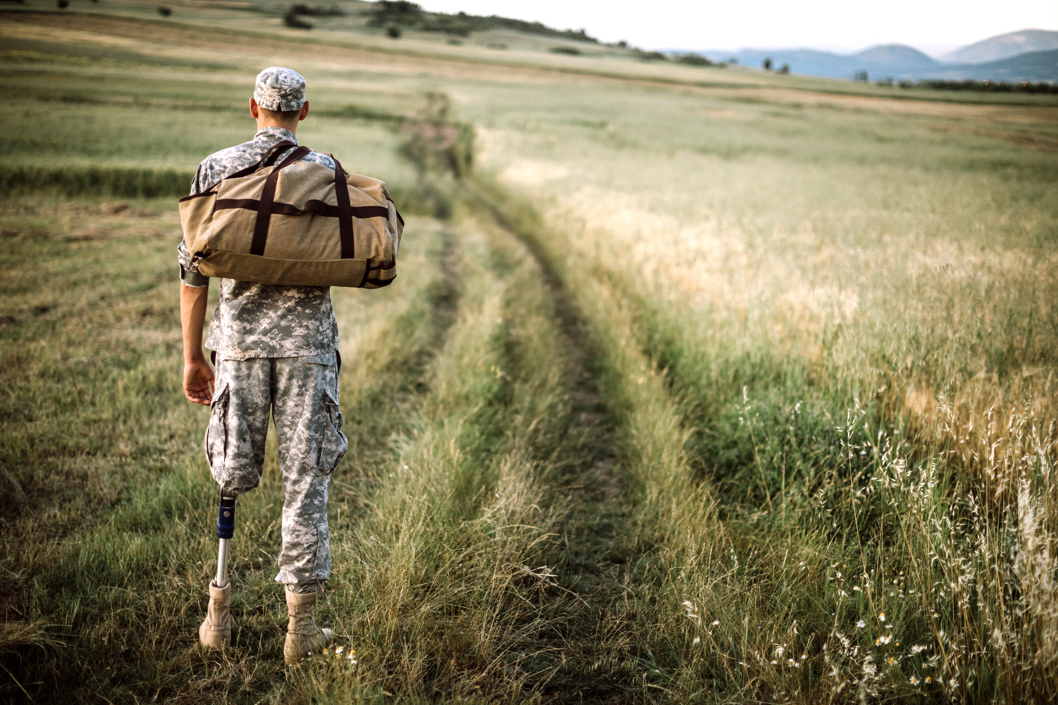
EMPOWERING IRON ATHLETES
OUR COMMITMENT TO IRON ATHLETES:
WHY IRON ATHLETES:
  Definition: "Iron Athletes" are exceptional individuals who have the desire and heart to triumph over physical and mental health issues to make an impact on their community, embodying resilience and strength.
  Purpose: Assist the athletes in regaining an active life through initial rehabilitation and beyond, showcasing their determination.
  Empowerment: Through our platform, donors directly contribute to our "Iron Athlete’s” programs, aiding in their journey towards achievement and active lives.
  Beyond Individuals: Donations not only support featured athletes but also enable all chosen athletes to engage in:
  Competitive and recreational sports
  Counseling
  Restoring confidence and fostering a sense of accomplishment.
JOIN US IN CHAMPIONING THE RESILIENCE OF IRON ATHLETES AND EMPOWERING THE BROADER COMMUNITY OF ACTIVE VETERANS.

Slide 6


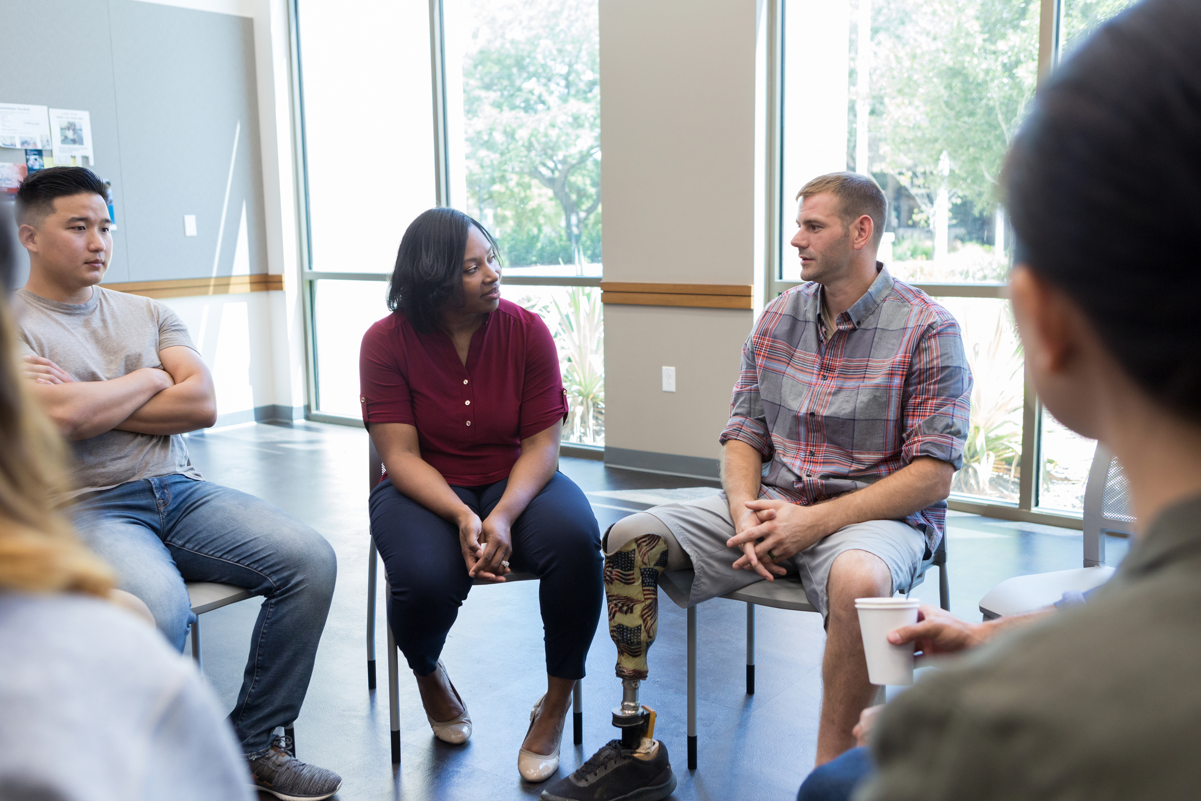
MARKET OPPORTUNITY
  Market Niche: FIT2SURVIVE WARRIOR FOUNDATION taps into a unique market by addressing the unmet needs of military personnel in the health and fitness sector. We cater specifically to this niche, offering comprehensive support beyond traditional rehabilitation.
  Market Size: With 15% of active duty and 25% of veterans suffering from mental health issues, our market size is significant. Statistics indicate a growing need for specialized services, including increased physical activity in reducing symptoms of depression by up to 30%.

Slide 7


BUSINESS MODEL
REVENUE STREAMS
SERVICES
  Donations: Contributions from individuals and corporate organizations passionate about our vision.
  Sponsorships: Partnerships with businesses supporting our mission, programs and “Iron Athletes.”
  Partnerships with VA Hospitals: Collaborations to extend our reach and impact.
  Apparel: Donors wear our brand with pride. Signifying unity among all athletes from all walks of life.
  Fitness Facility: Membership donations to our future planned state of the art fitness facility.
  Specialized Equipment: Providing custom and non custom equipment to enhance mobility, comfort and athletics.
  Hospital And Individual Support: Extending aid to hospitals and individuals through targeted donations, ensuring comprehensive care and counseling.
  Active Lifestyle Support: Providing sponsorships, specialized equipment, coaching, training, facility and coverage for travel and entry fees, as well as competitive sports and recreational events.
THIS DYNAMIC BUSINESS MODEL ENABLES FIT2SURVIVE WARRIOR FOUNDATION TO PROVIDE COMPREHENSIVE ASSISTANCE WHILE ENSURING LONG-TERM SUSTAINABILITY AND GROWTH.

Slide 8

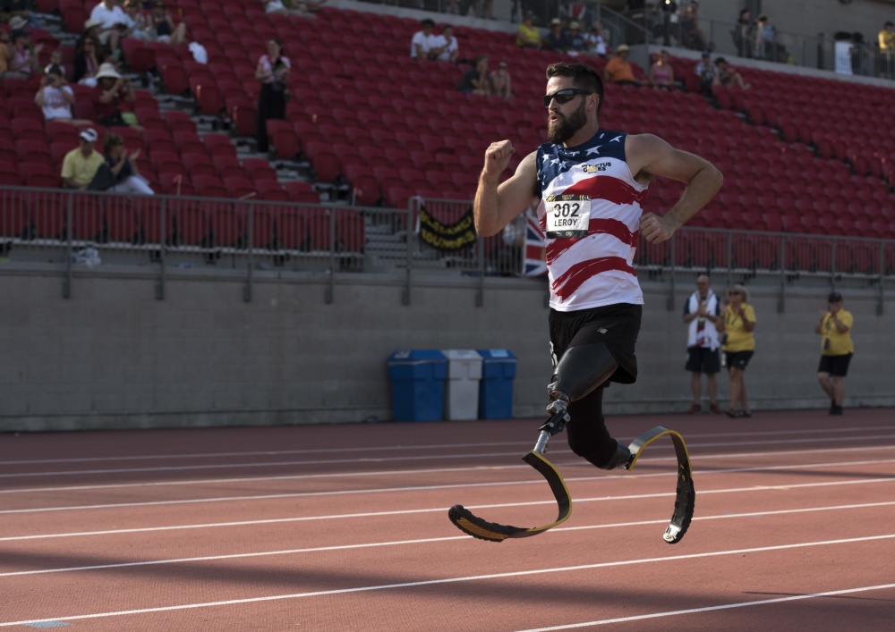
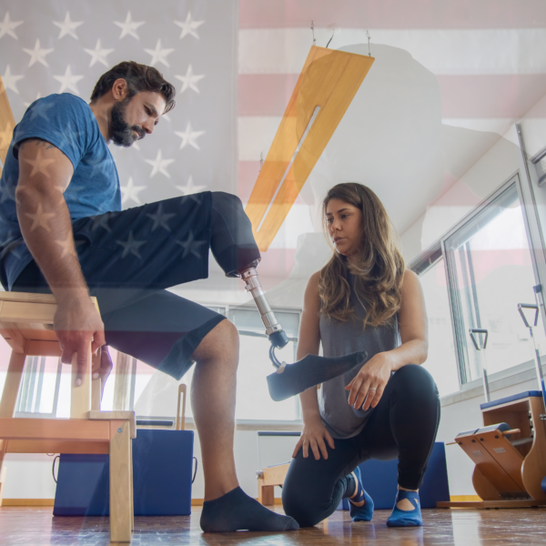
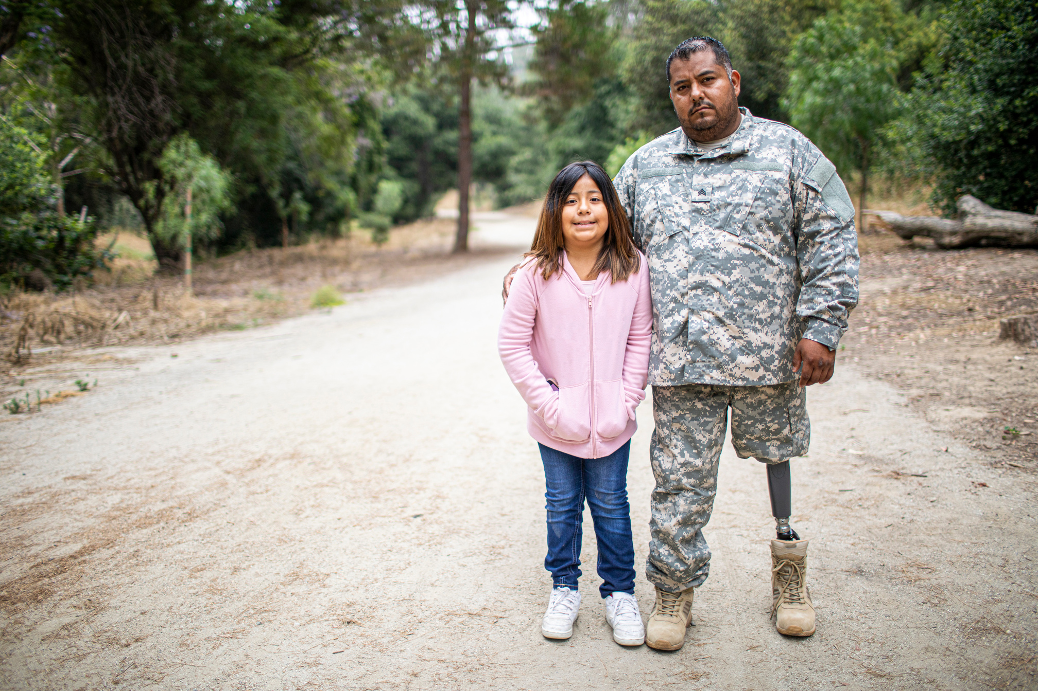
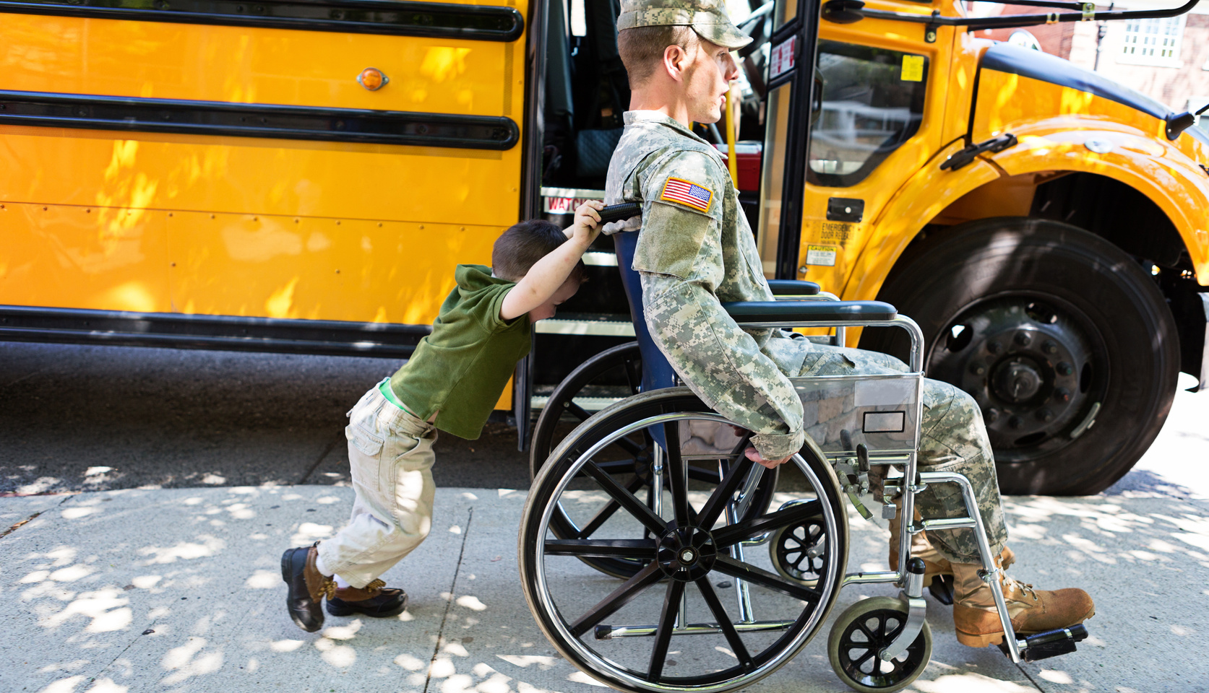
OUR IMPACT
Discover the real-world impact of FIT2SURVIVE WARRIOR FOUNDATION INC through compelling case studies showcasing the transformative journeys of our Iron Athletes and fitness facing programs. Hear directly from beneficiaries and partners through powerful testimonials, affirming the positive change we bring to the lives of those we support. From regaining mobility to conquering fitness goals, to counseling and overcoming mental health constraints. These stories and quotes exemplify the tangible results of our commitment to empowerment.
OUR WEBSITE - FIT2SURVIVEWARRIORFOUNDATION.ORG (F2SWF.ORG)

Slide 9

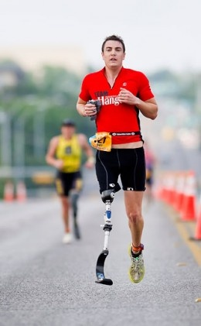
COMPETITIVE ANALYSIS
Similar Organizations:
In assessing our landscape, we have identified organizations such as the Amputee Coalition, Wounded Warriors, and Adaptive Training Foundation. These entities focus on various aspects of support, ranging from statistical information to health programs.
Our Unique Value Proposition:
FIT2SURVIVE WARRIOR FOUNDATION INC stands out through its holistic approach. Unlike competitors, we not only seek to enhance physical abilities but also mental stability. We provide specialized equipment, counseling and coaching to actively support our heroes in achieving a fulfilling life. Our emphasis on personalized guidance, event sponsorships, and comprehensive adaptive wellness, positions us as a unique and impactful force in empowering military heroes. *Currently seeking funding for a state of the art fitness facility open to all and catering to our military personnel.

Slide 10

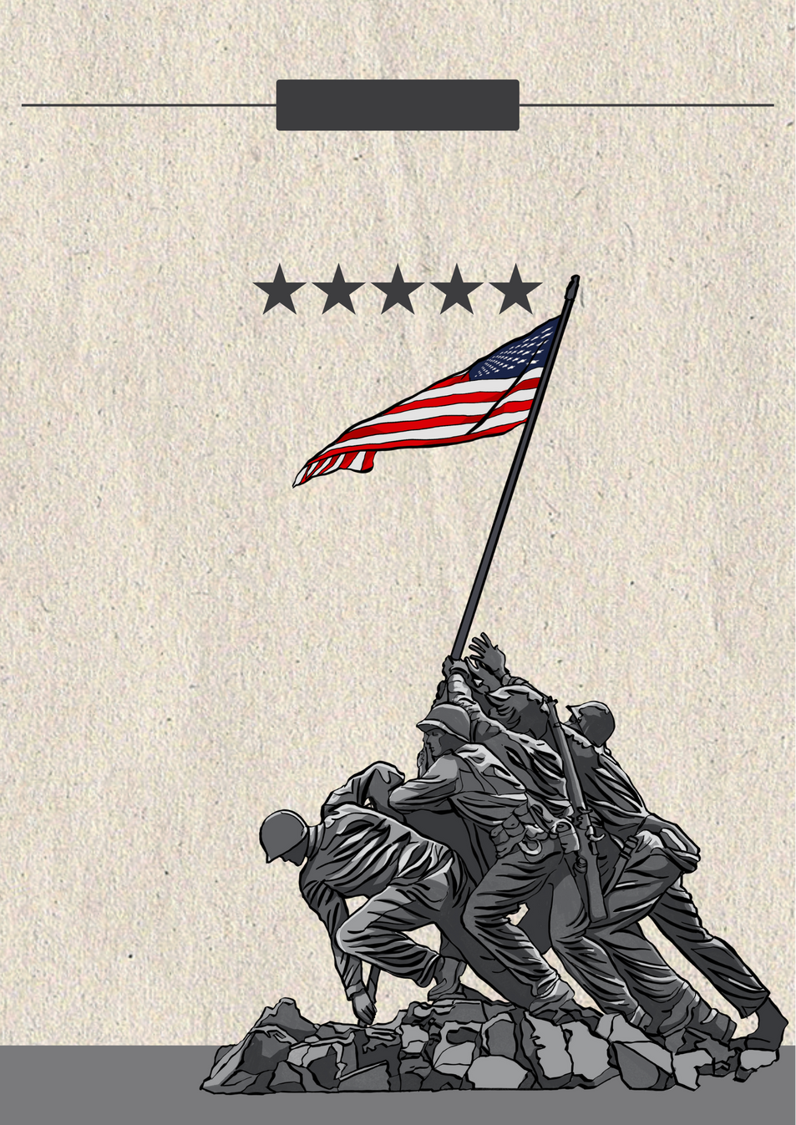
MARKETING STRATEGY
Branding: Our visual identity is a symbol of strength, resilience, and triumph. Through emotional appeal and community forward thinking, we connect deeply with our audience, portraying consistency in our mission to empower all our service men and women.
Online Presence: Engaging through social media platforms, we share inspiring stories and foster engagement. Our website, FIT2SURVIVEWARRIORFOUNDATION.ORG, (F2SWF.ORG) serves as a hub of information, showcasing our Iron Athletes, objective, initiatives and impact, providing an overview of our unwavering support.

Slide 11

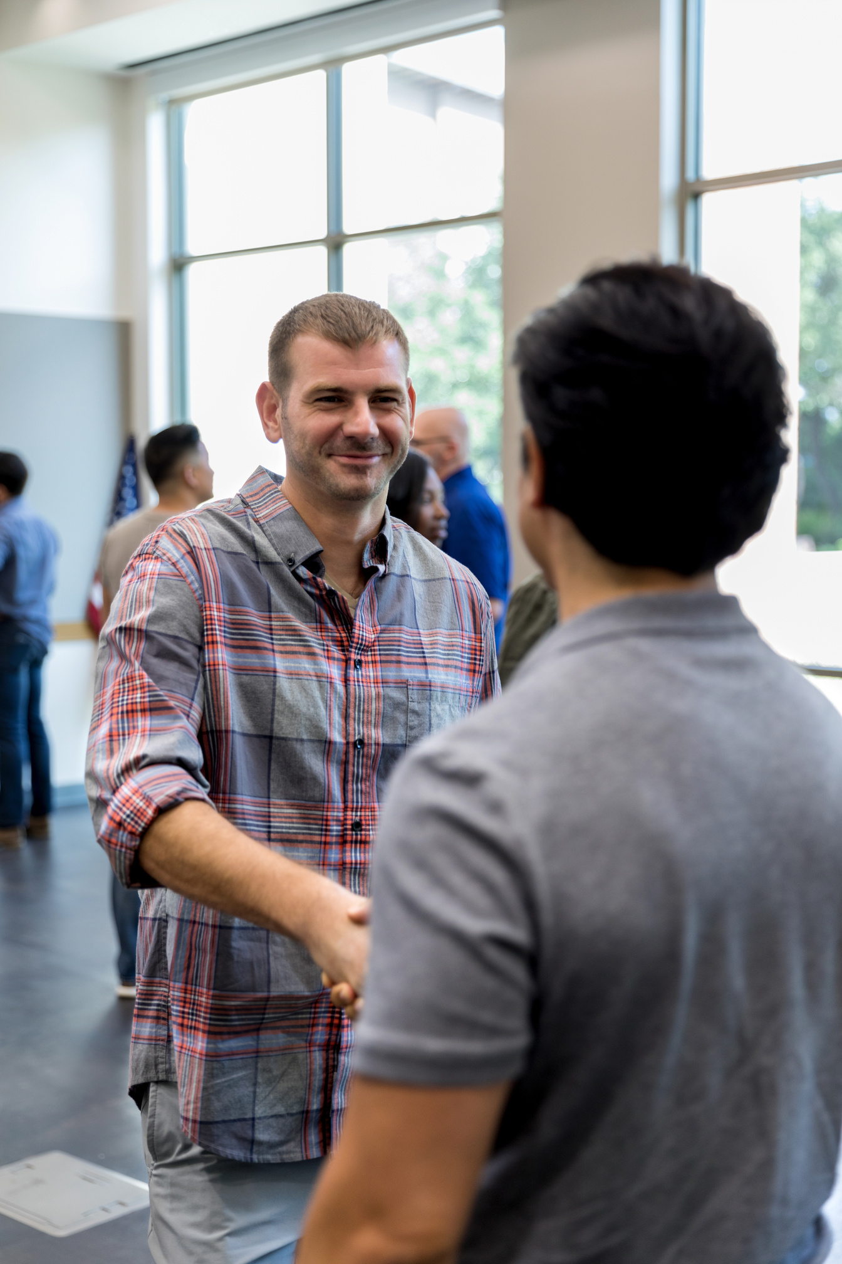
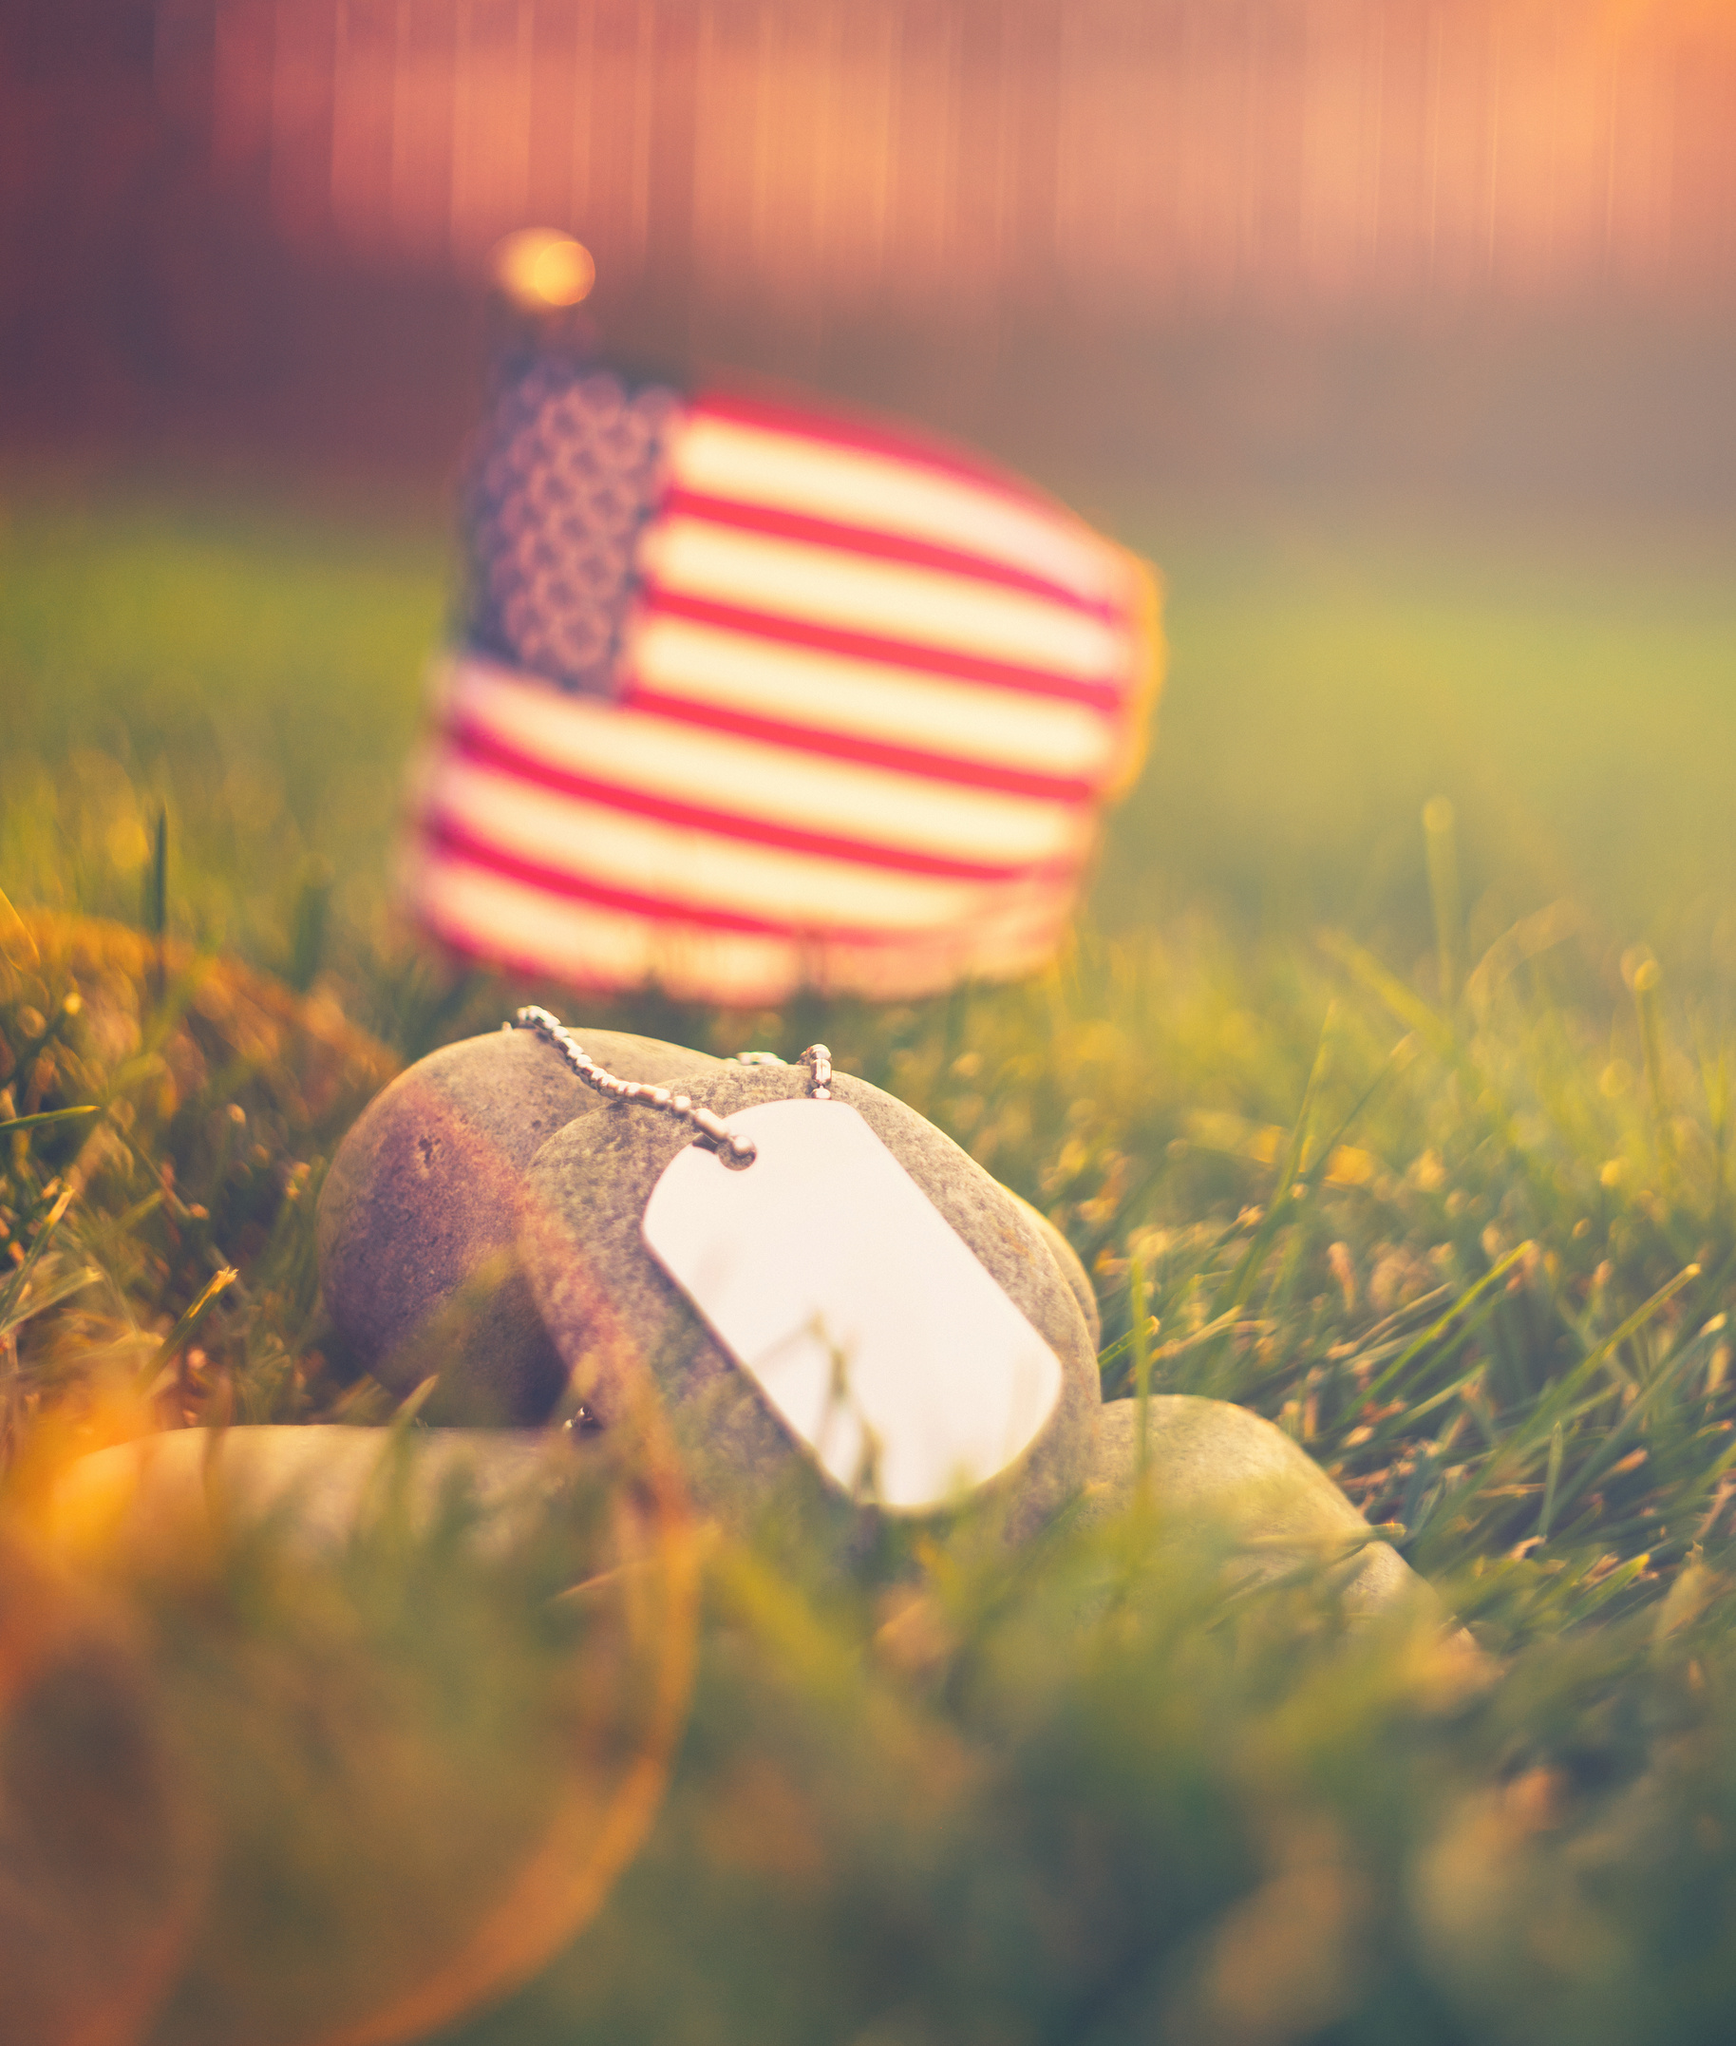
OUTREACH INITIATIVES
Events & Sponsorships: Engage with our audience by actively participating in key events relevant to health and fitness. Forging strategic partnerships while seeking sponsorships to enhance our visibility and impact in the community.
Community Engagement: Foster a sense of community through online forums, blogs, providing a supportive space for our heroes and athletes, donors, and well-wishers. Hosting live events for direct interaction, and collaborating with organizations to amplify our reach and effectiveness.

Slide 12



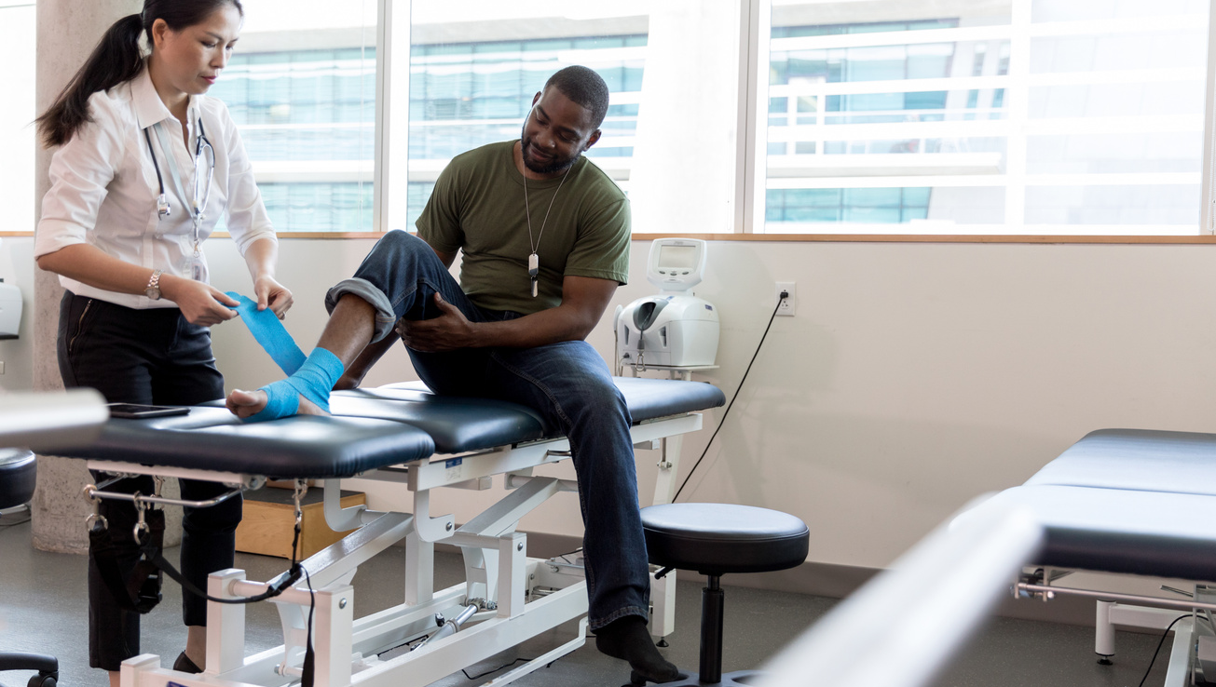
TARGET AUDIENCE
1. PRIMARY AUDIENCE
2. SECONDARY AUDIENCE
Military personnel struggling with physical injuries and mental health issues, who need tailored fitness programs and counseling support to aid their recovery and reintegration. Supporters include direct donors, sponsors, fitness enthusiasts, professional sports teams along with active and veteran military personnel.
Those that can help amplify the reach and impact of our services, fostering a community that empowers our heroes in their pursuit of a fulfilling life. Supporters include Military families, networks of caregivers, community organizations, VA administrations and hospitals who play a crucial role in providing emotional and logistical support to service members.

Slide 13

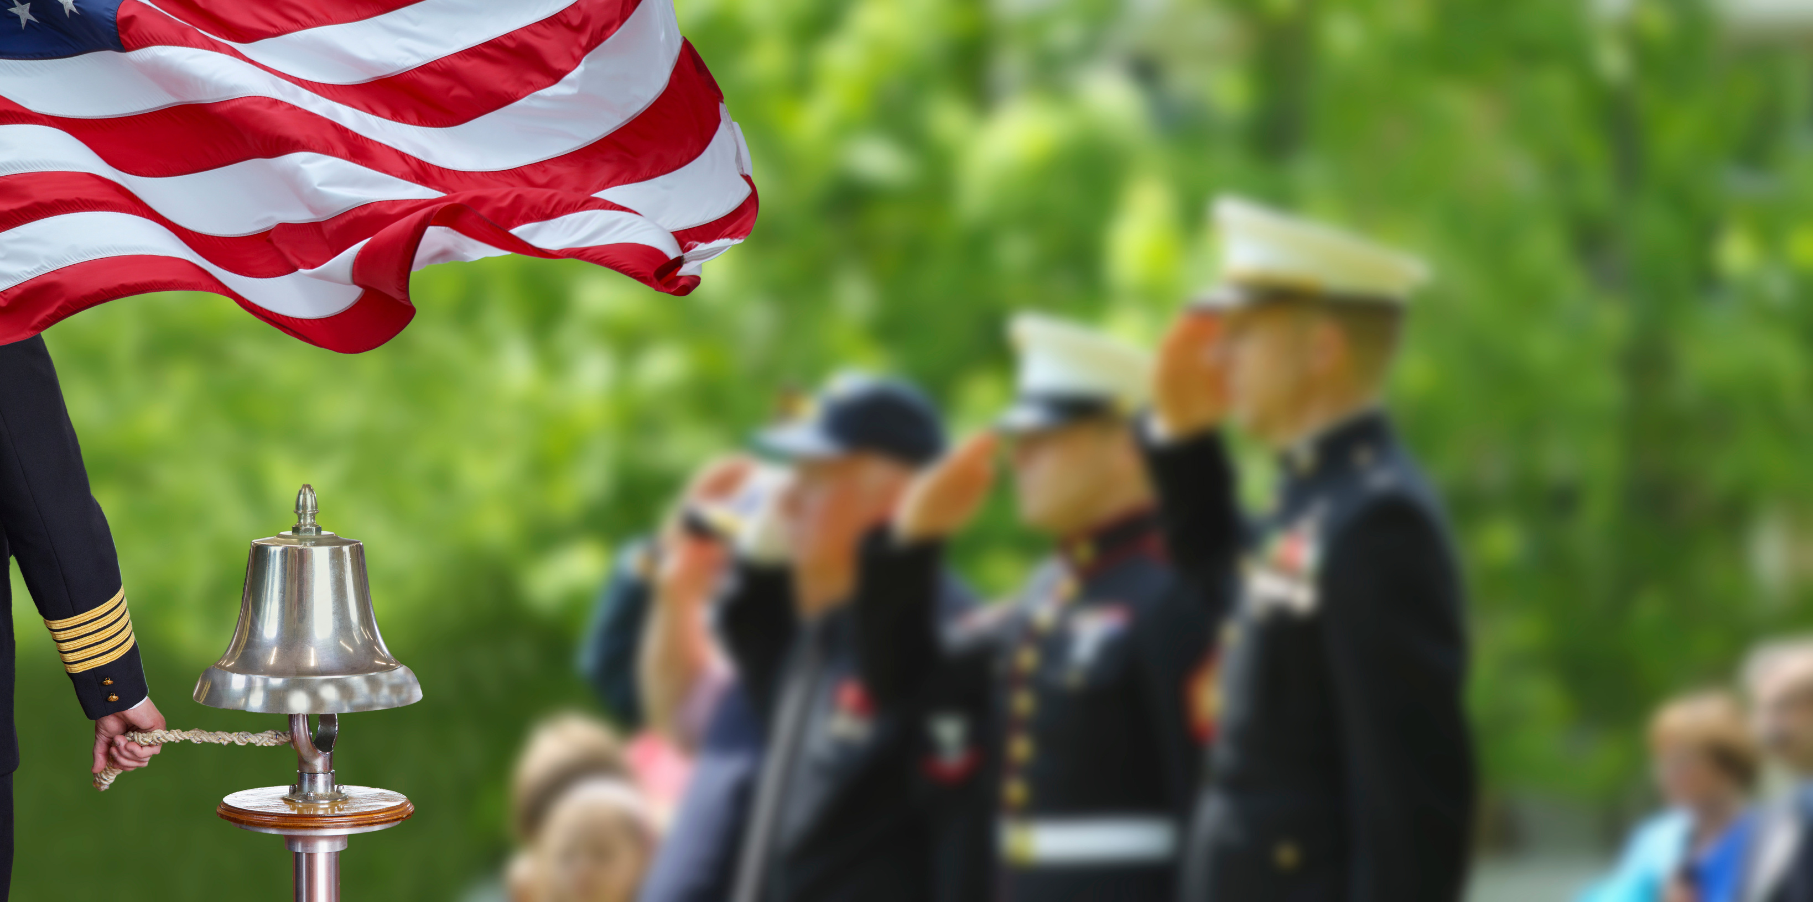
GROWTH & SCALABILITY
Expansion Plans
Scalability
Our growth trajectory spans from statewide to nationwide impact. We aim to establish a strong presence in key regions, extending our reach to serve military heroes across the nation. With plans to begin state of the art open to the pubic donation for membership fitness and training facilities where all service men and women are welcome.
To maximize our impact, we focus on scalable operations. Leveraging technology, strategic partnerships, and streamlined processes, we ensure our foundation can efficiently scale its initiatives and support an increasing number of veterans and supporters.

Slide 14

“We shall draw from the heart of suffering
the means of inspiration and survival.”

Slide 15

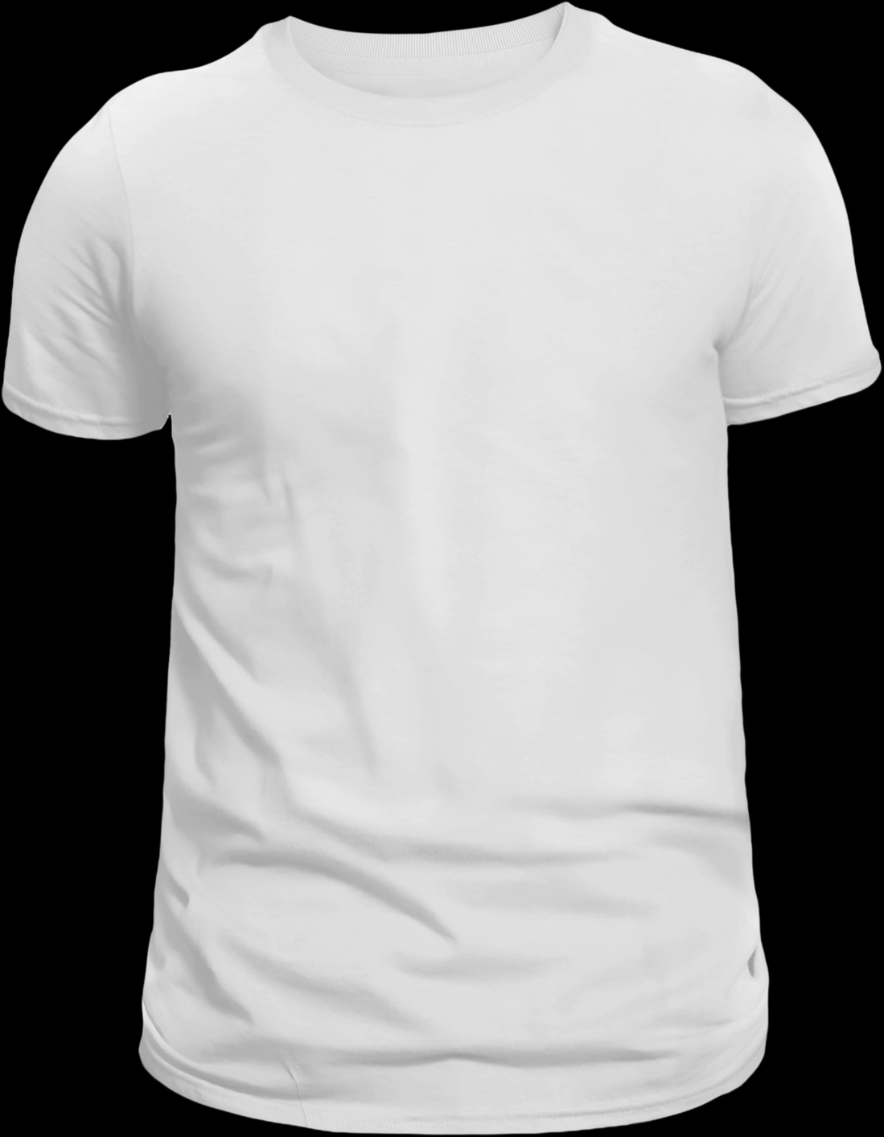

A CALL TO ACTION
Your contributions make a difference—whether through donations, volunteering, or partnering with FIT2SURVIVE WARRIOR FOUNDATION INC. Join us in Supporting Our Journey to active and fulfilling lives.
Contact Information:
  Website: F2SWF.ORG
  Email: INFO@F2SWF.COM
  Phone: 727-418-7026
For further inquiries and collaboration opportunities, email us today.
Together, let's make a lasting impact on the lives of our nation's heroes.

