Slide 1
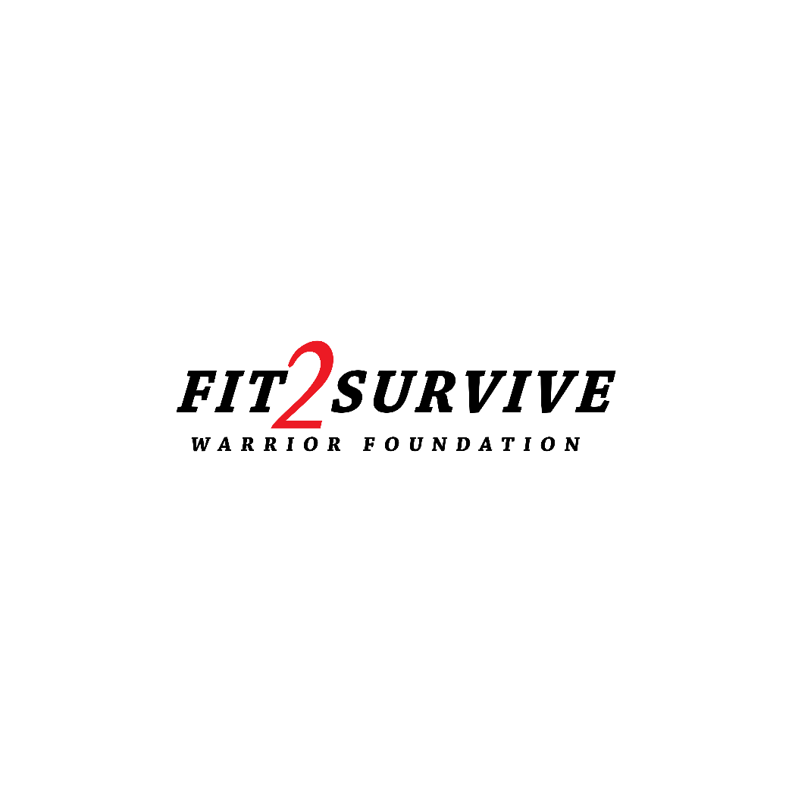
FIT2SURVIVE WARRIOR FOUNDATION INC
Empowering Military Amputees for Active Lives

Slide 2
PROBLEMS STATEMENT
Problem: Limited Support for Military Amputees Post-Rehabilitation.
Many military amputees face a significant gap in support after rehabilitation, hindering their journey to active and fulfilling lives.
Statistics:
Over 60% of military amputees struggle with inadequate post-rehabilitation assistance.
42% report challenges in accessing specialized prosthetics and fitness resources.
Lack of comprehensive support contributes to a 35% drop in participation in active lifestyle pursuits.
Addressing this gap is crucial for enhancing the well-being of our military amputee heroes.

Slide 3
OUR SOLUTION: EMPOWERING AMPUTEE VETERANS
At FIT2SURVIVE WARRIOR FOUNDATION INC, we offer a holistic approach to support military amputees. Our comprehensive solution includes:
Specialized Prosthetics: Tailored to individual needs for enhanced mobility.
Fitness Programs: Enabling physical and mental well-being for active lifestyles.
Event Participation: Sponsorships and support for amputee veterans in competitive and recreational events.
Together, these elements form a powerful support system, empowering our heroes to overcome challenges and thrive in their pursuit of a fulfilling life.

Slide 4
MISSION
VISION
Support and inspire our service men and women amputees, through comprehensive education, specialized equipment, individual and event sponsorships.
Empower all military amputees to exceed their health and fitness goals, leading to more active fulfilling lives.

Slide 5
EMPOWERING IRON ATHLETES
OUR COMMITMENT TO IRON ATHLETES:
WHY IRON ATHLETES:
Definition: "Iron Athletes" are exceptional individuals who have triumphed over limb loss, embodying resilience and strength.
Purpose: We select one amputee military veteran annually as our featured "Iron Athlete," showcasing their inspiring story on our website, social media, and fundraising events.
Empowerment: Through our platform, donors directly contribute to an "Iron Athlete's" goals and required equipment, aiding in their journey towards an active life post-rehabilitation.
Beyond Individuals: Donations not only support featured athletes but also enable all amputee veterans to engage in competitive and recreational sports, restoring confidence and fostering a sense of achievement.
JOIN US IN CHAMPIONING THE RESILIENCE OF IRON ATHLETES AND EMPOWERING THE BROADER COMMUNITY OF AMPUTEE VETERANS.

Slide 6
MARKET OPPORTUNITY
Market Niche: FIT2SURVIVE WARRIOR FOUNDATION INC taps into a unique market by addressing the unmet needs of military amputees in the health and fitness sector. We cater specifically to this niche, offering comprehensive support beyond traditional rehabilitation.
Market Size: With a substantial population of amputee veterans seeking enhanced health and fitness, our market size is significant. Statistics indicate a growing need for specialized services, showcasing substantial growth potential in our targeted demographic.

Slide 7
BUSINESS MODEL
REVENUE STREAMS
SERVICES
Donations: Contributions from individuals and organizations passionate about our cause.
Sponsorships: Partnerships with businesses supporting our mission financially.
Partnerships with VA Hospitals: Collaborations to extend our reach and impact.
Apparel: Donors wear our brand with pride. "Iron Athletes" get red shirts, symbolizing support for military amputees, with the red "2" in our logo signifying unity.
Prosthetics: Specialized limb solutions tailored to individual needs.
Fitness Equipment: Access to adaptive workout gear for amputee-friendly training.
Event Sponsorships: Funding and support for amputees participating in active events.
Donations: Contributions to hospitals and individuals aiding amputee veterans.
THIS DYNAMIC BUSINESS MODEL ENABLES FIT2SURVIVE WARRIOR FOUNDATION TO PROVIDE COMPREHENSIVE ASSISTANCE WHILE ENSURING LONG-TERM SUSTAINABILITY AND GROWTH.

Slide 8
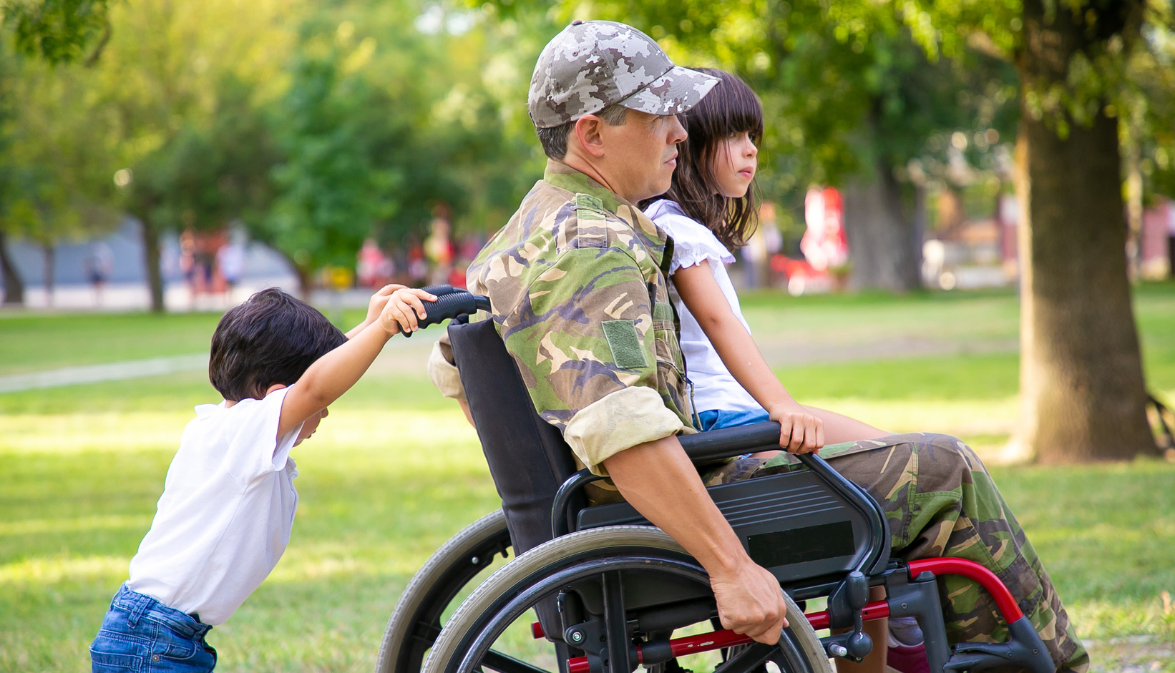
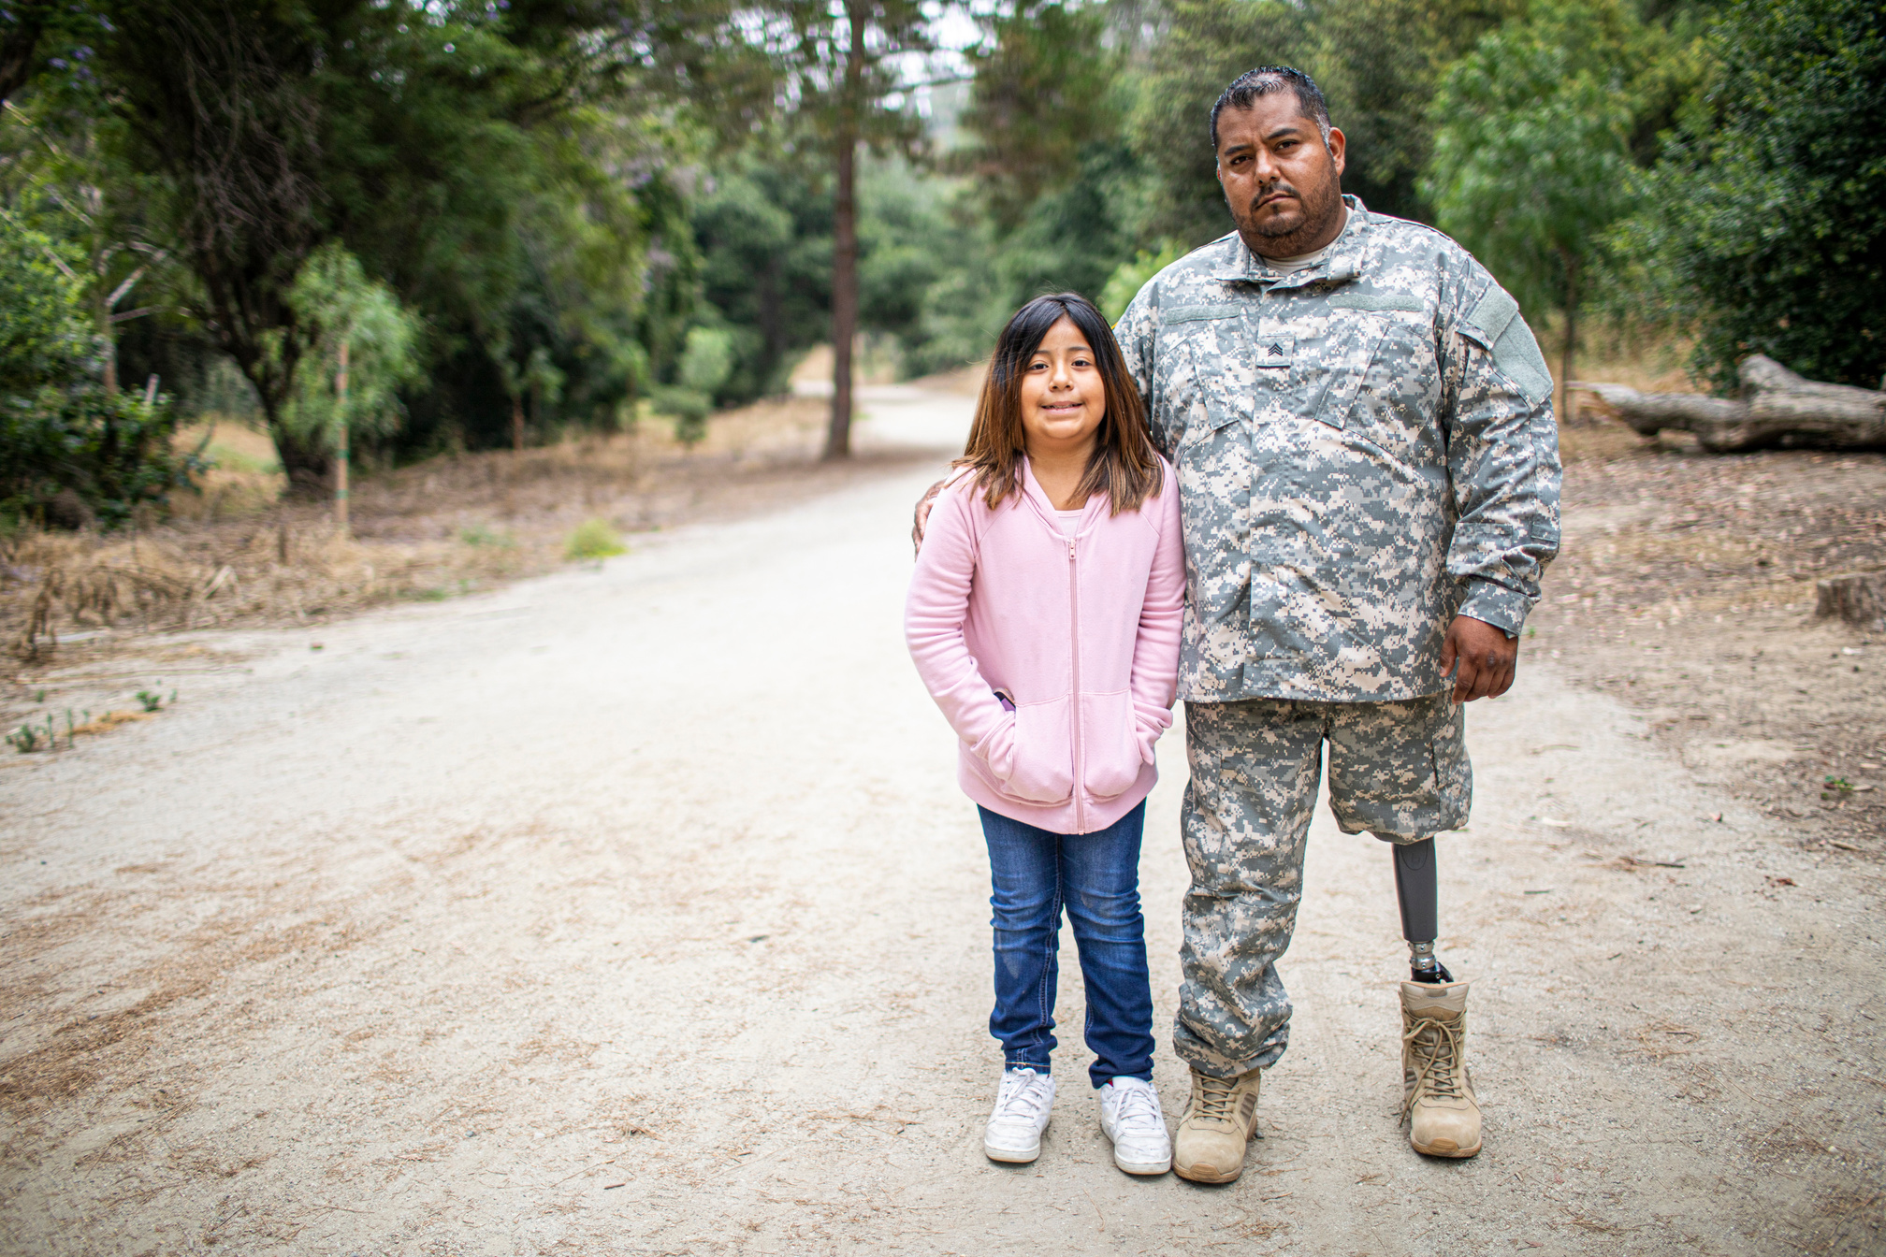
OUR IMPACT
Discover the real-world impact of FIT2SURVIVE WARRIOR FOUNDATION INC through compelling case studies showcasing the transformative journeys of amputees. Hear directly from beneficiaries and partners through powerful testimonials, affirming the positive change we bring to the lives of those we support. From regaining mobility to conquering fitness goals, these stories and quotes exemplify the tangible results of our commitment to amputee empowerment.
ON OUR WEBSITE - FIT2SURVIVEWARRIORFOUNDATION.ORG

Slide 9
COMPETITIVE ANALYSIS
Similar Organizations:
In assessing our landscape, we have identified organizations such as the Amputee Coalition, Wounded Warriors, and Adaptive Training Foundation. These entities focus on various aspects of amputee support, ranging from statistical information to adaptive training programs.
Our Unique Value Proposition:
FIT2SURVIVE WARRIOR FOUNDATION INC stands out through its holistic approach. Unlike competitors, we not only provide specialized prosthetics and equipment but also actively support amputees in achieving higher fitness levels through participation in competitive sports. Our emphasis on personalized support, event sponsorships, and a comprehensive wellness approach positions us as a unique and impactful force in empowering military amputees.

Slide 10
MARKETING STRATEGY
Branding: Our visual identity is a symbol of strength, resilience, and triumph. Through emotional appeal, we connect deeply with our audience, portraying consistency in our mission to empower military amputees.
Online Presence: Engaging through social media platforms, we share inspiring stories and foster a supportive community. Our website, FIT2SURVIVEWARRIORFOUNDATION.ORG, serves as a hub for information, showcasing our initiatives, impact, and providing an overview of our comprehensive support for amputee veterans.

Slide 11
OUTREACH INITIATIVES
Events & Sponsorships: Engage with our audience by actively participating in key events relevant to amputee support, health, and fitness. Forge strategic partnerships and seek sponsorships to enhance our visibility and impact in the community.
Community Engagement: Foster a sense of community through online forums, providing a supportive space for amputees, donors, and well-wishers. Host live events for direct interaction, and collaborate with organizations to amplify our outreach and effectiveness.

Slide 12
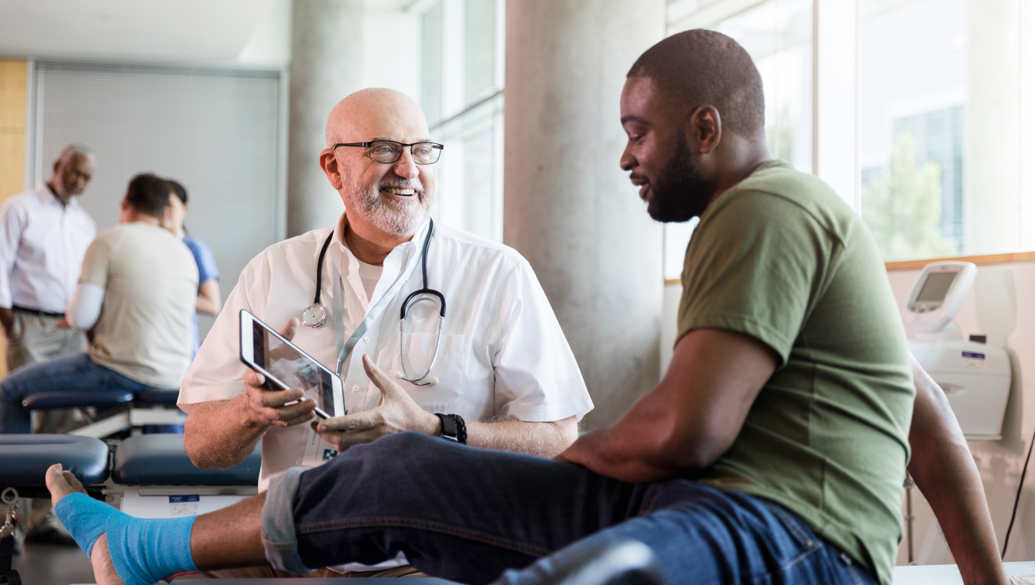
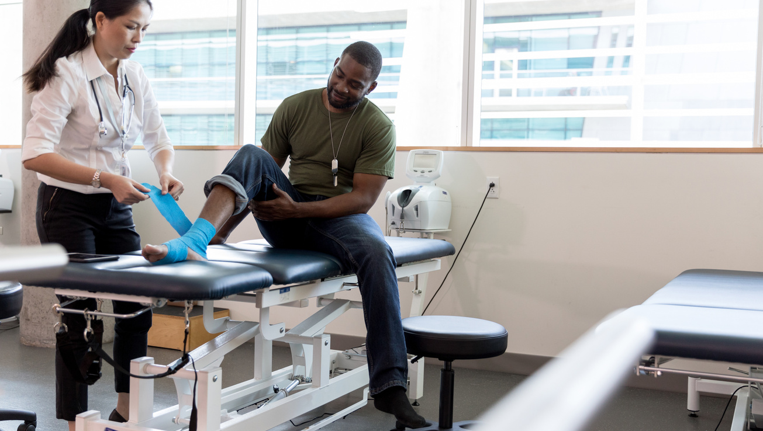
TARGET AUDIENCE
1. PRIMARY AUDIENCE
2. SECONDARY AUDIENCE
Our primary focus is on serving military hospitals, VA administrations, and amputee veterans.
By directly engaging with these key stakeholders, we aim to provide specialized support, prosthetics, and fitness resources tailored to their unique needs.
In addition to our primary targets, we actively seek support from donors, supporters, and fitness enthusiasts.
This secondary audience plays a crucial role in sustaining our mission, contributing to our initiatives, and fostering a community that empowers military amputees in their pursuit of active and fulfilling lives.

Slide 13
GROWTH & SCALABILITY
Expansion Plans
Scalability
Our growth trajectory spans from statewide to nationwide impact. We aim to establish a strong presence in key regions, extending our reach to serve military amputees across the nation.
To maximize our impact, we focus on scalable operations. Leveraging technology, strategic partnerships, and streamlined processes, we ensure our foundation can efficiently scale its initiatives and support an increasing number of amputee veterans.

Slide 14
"Strength knows no bounds, and neither does resilience. In the face of sacrifice, amputee military heroes redefine courage, proving that true warriors adapt, overcome, and inspire us all."

Slide 15
CALL TO ACTION
Join us in empowering military amputees. Your contributions make a difference—whether through donations, volunteering, or partnering with FIT2SURVIVE WARRIOR FOUNDATION INC. Be a part of their journey to active and fulfilling lives.
Contact Information:
Website: FIT2SURVIVEWARRIORFOUNDATION.ORG
Email: FIT2SURVIVEWARRIORFOUNDATION@GMAIL.COM
Phone: 727-418-7026
For further inquiries and collaboration opportunities, connect with us today.
Together, let's make a lasting impact on the lives of our nation's heroes.

